Slide 1
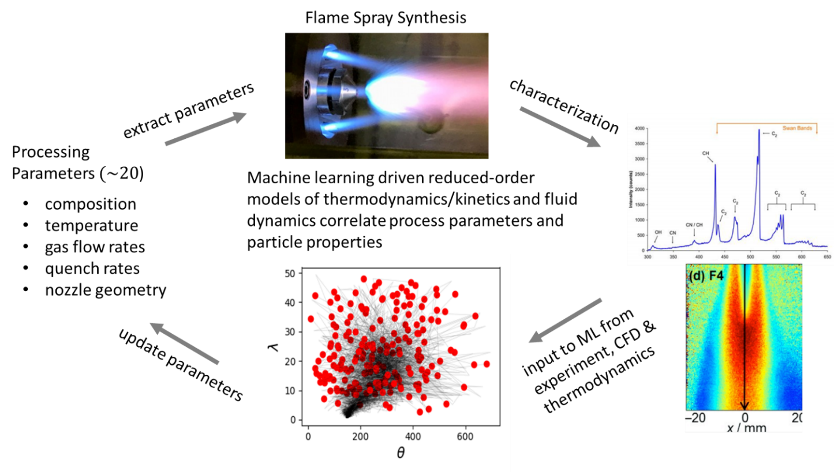
Strategy:
M. Stan et al., 2019, in preparation

Slide 2
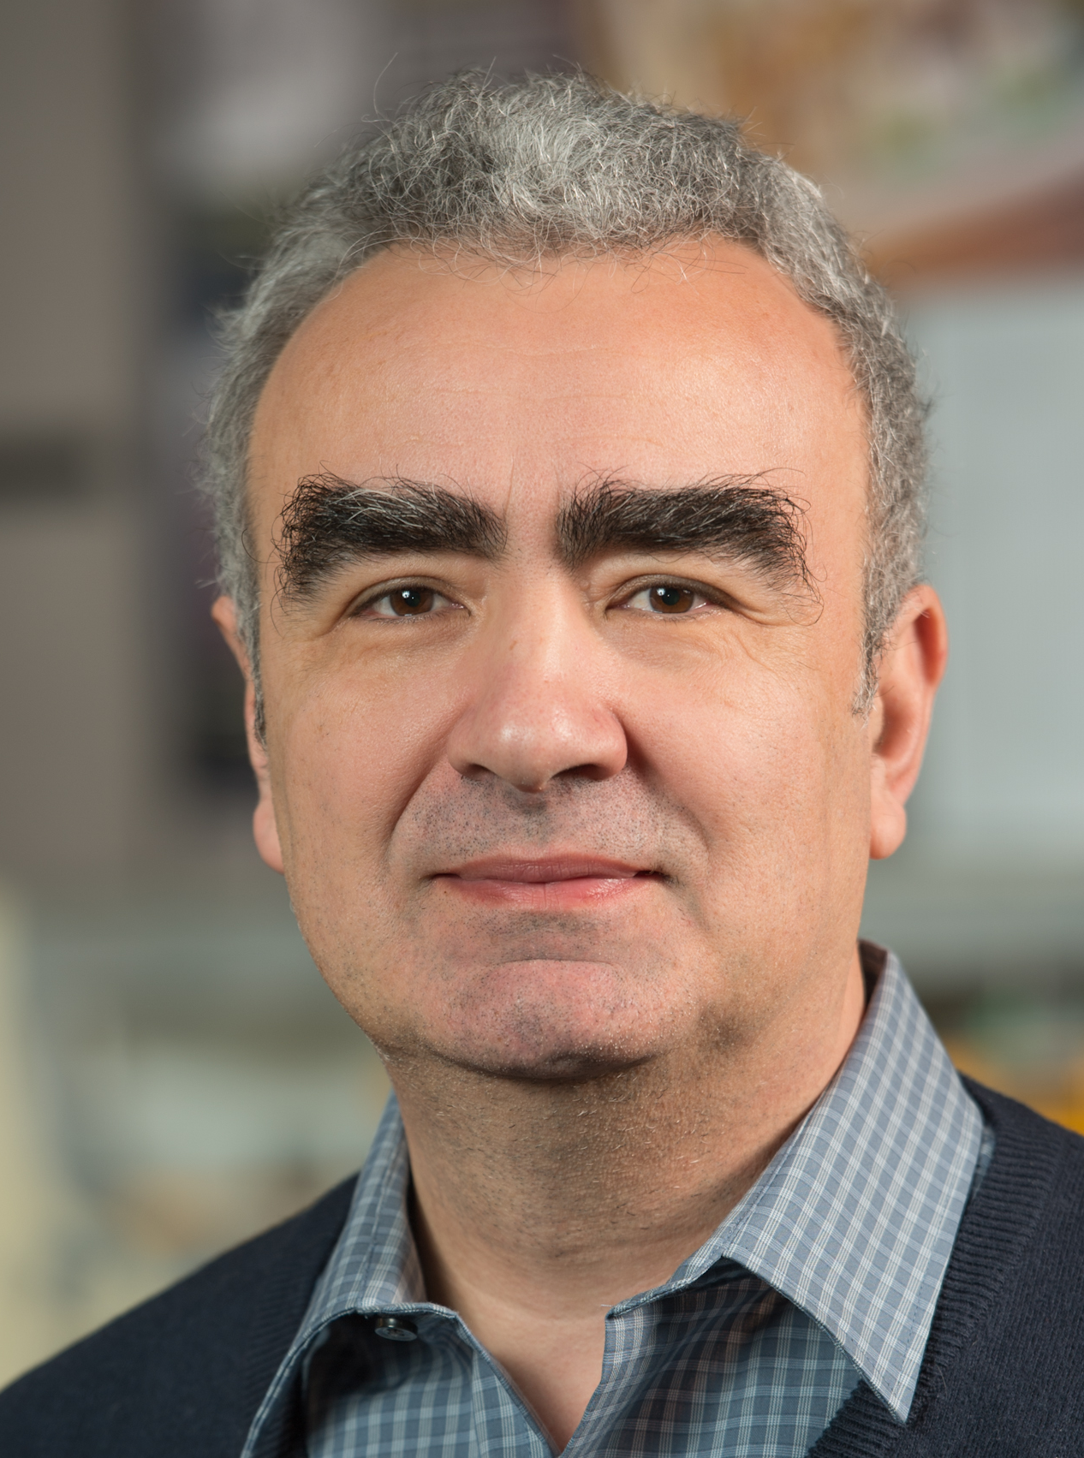
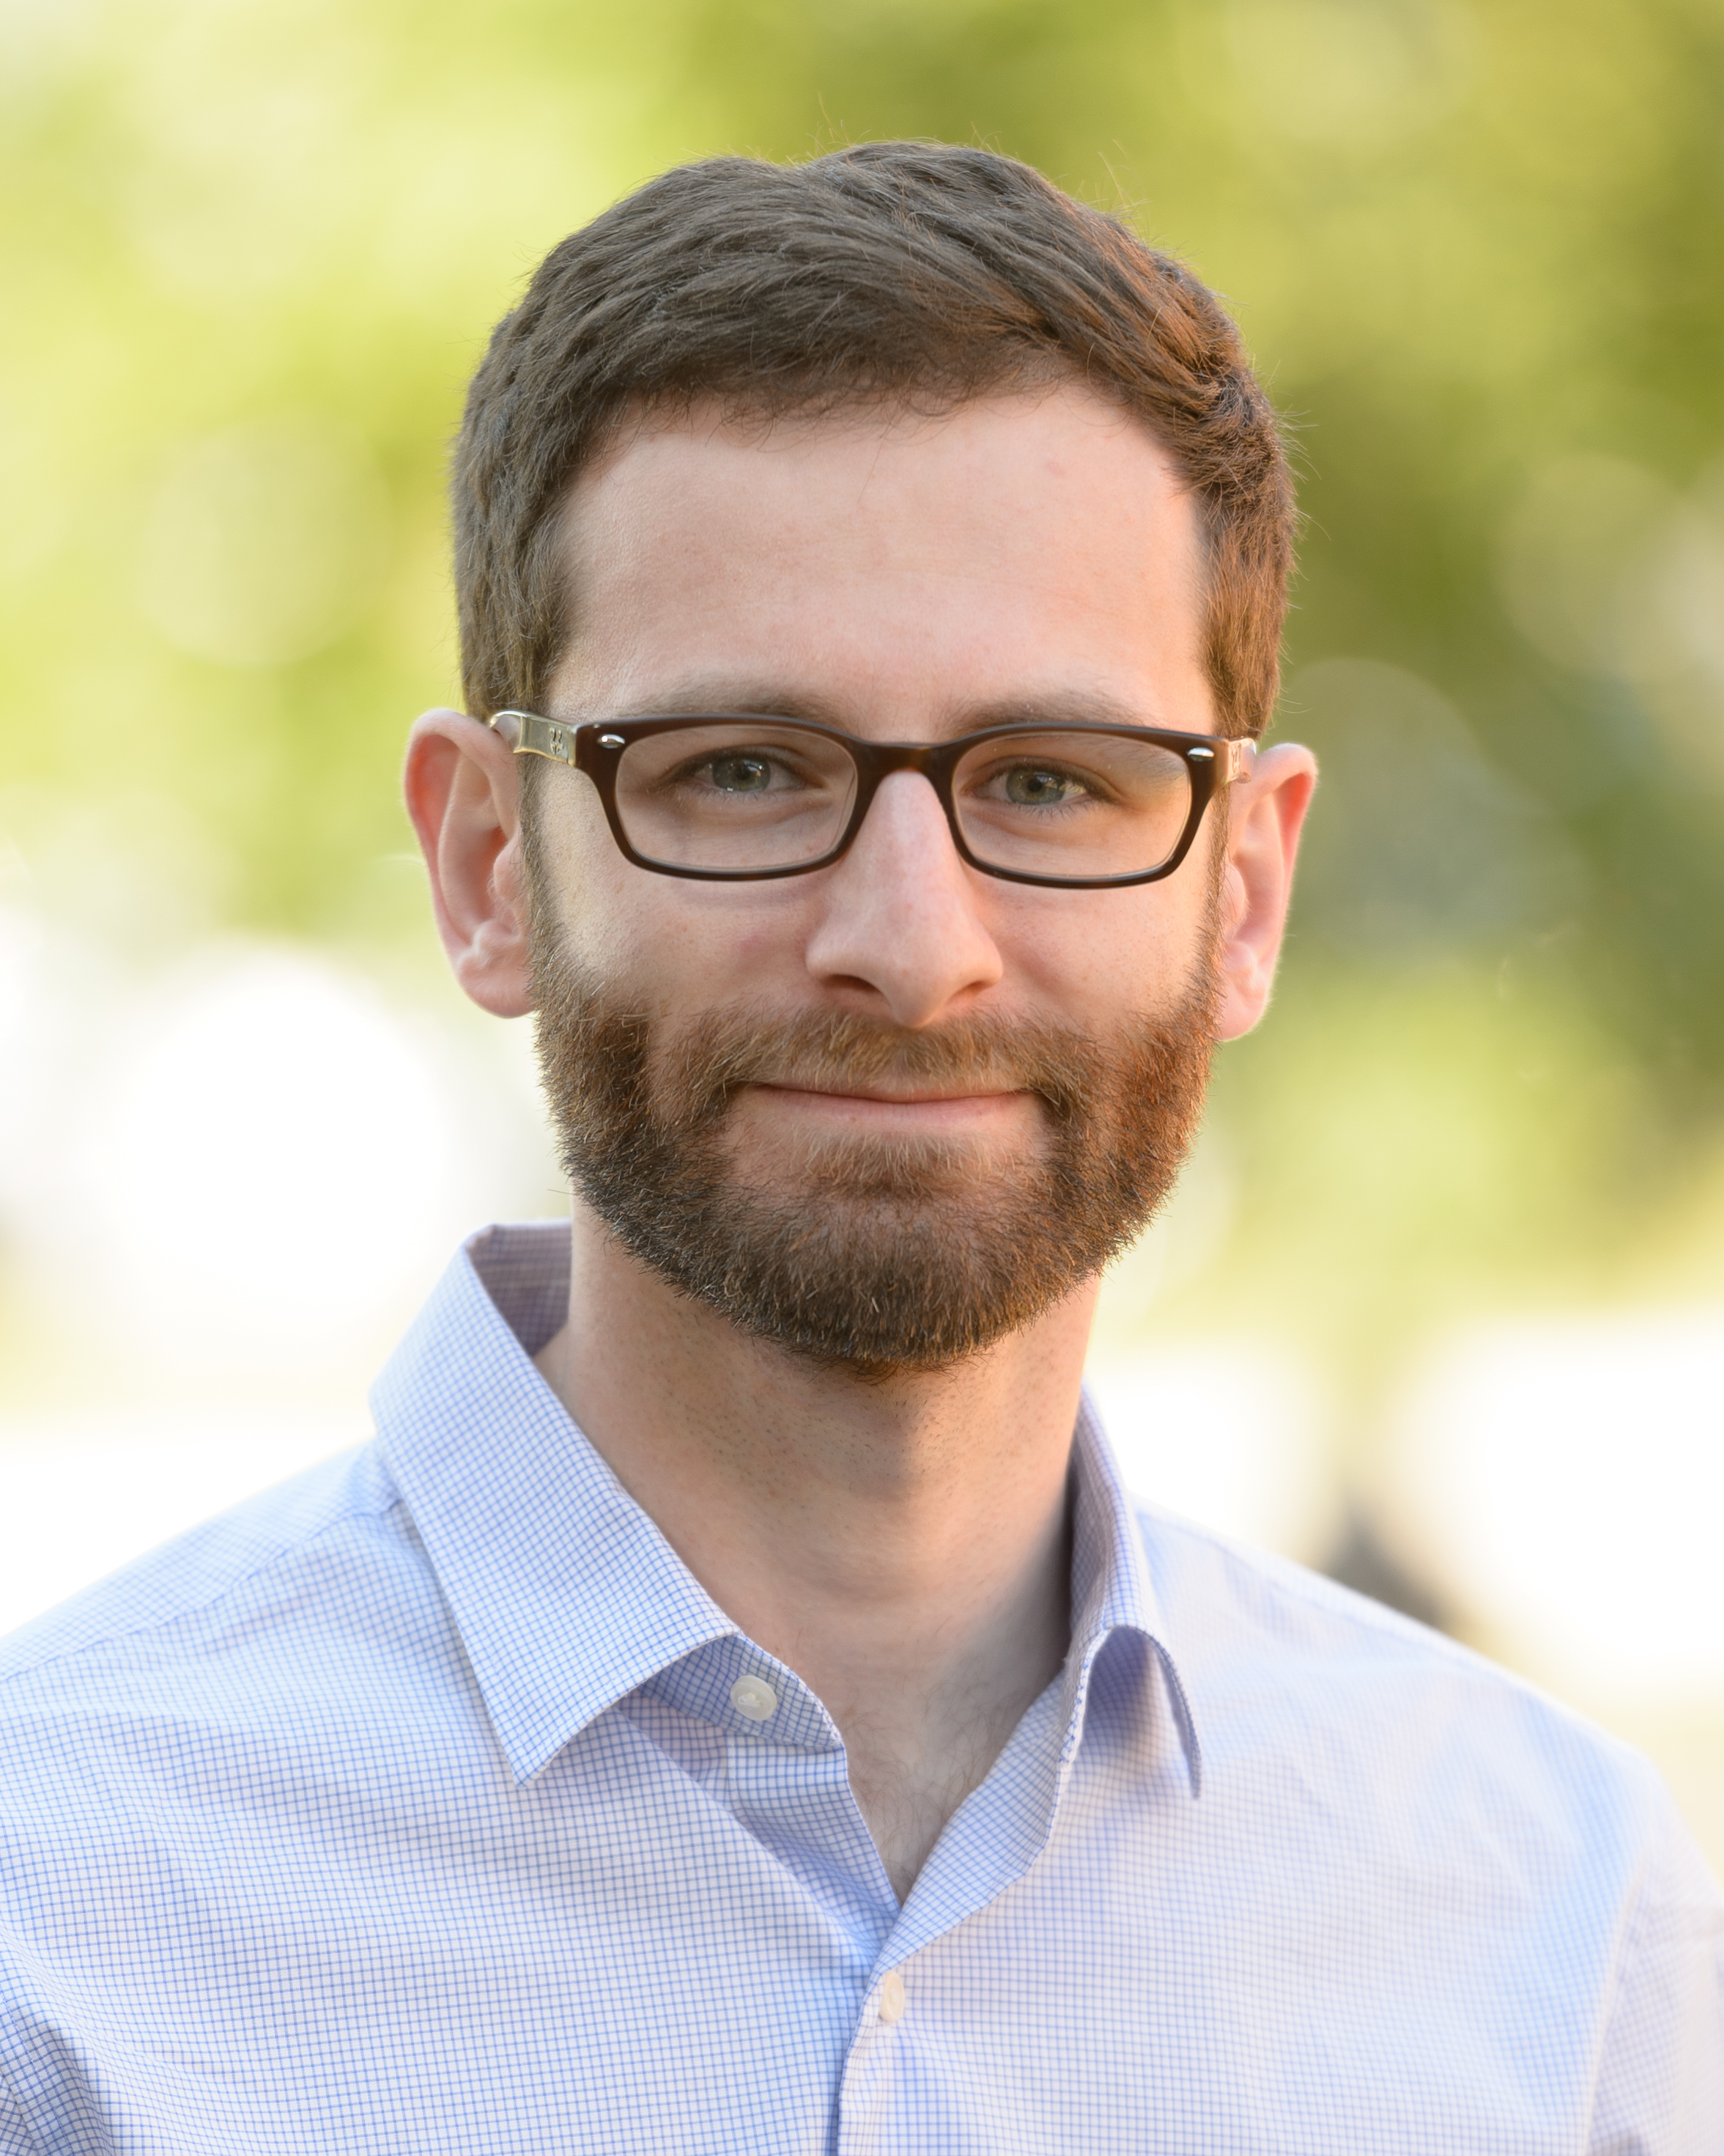
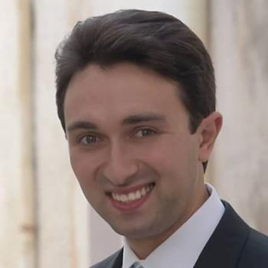

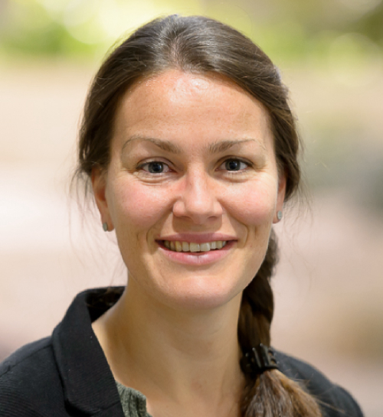
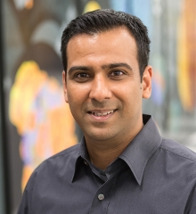
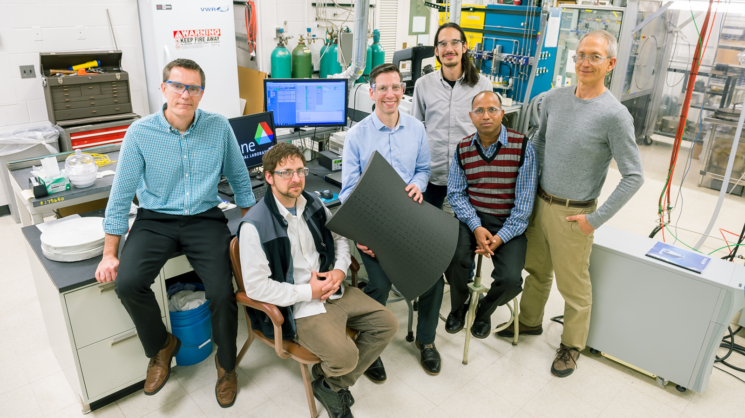

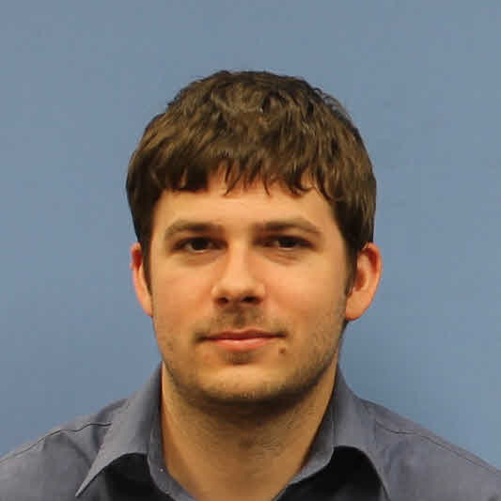
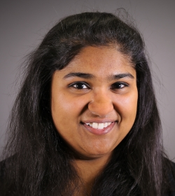
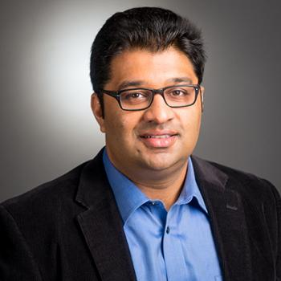
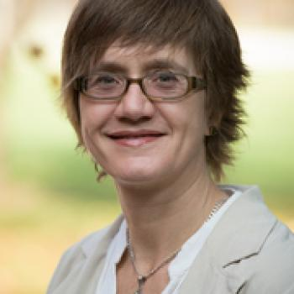
FY19 Team and Accomplishments
Investigators
Marius Stan (AMD) PI,Thermo, ML
Noah Pauson (AMD) ML, Bayesian
Roberto Torelli (ES) CFD
Pinaki Pal (ES) CFD, Thermo
Elise Jennings (LCF) Bayesian Statistics
Venkat Vishwanath (LCF) ML
Collaborators
Joe Libera (AMD) Flame Spray Pyrolysis
Robert Trenter (CSE) Thermo-Chem.
Travis Sikes (CSE) Thermo-Chem.
Debolina Dasgupta (ES) CFD
Sibendu Som (ES) CFD
Nicola Ferrier (MCS) computer vision

Slide 3
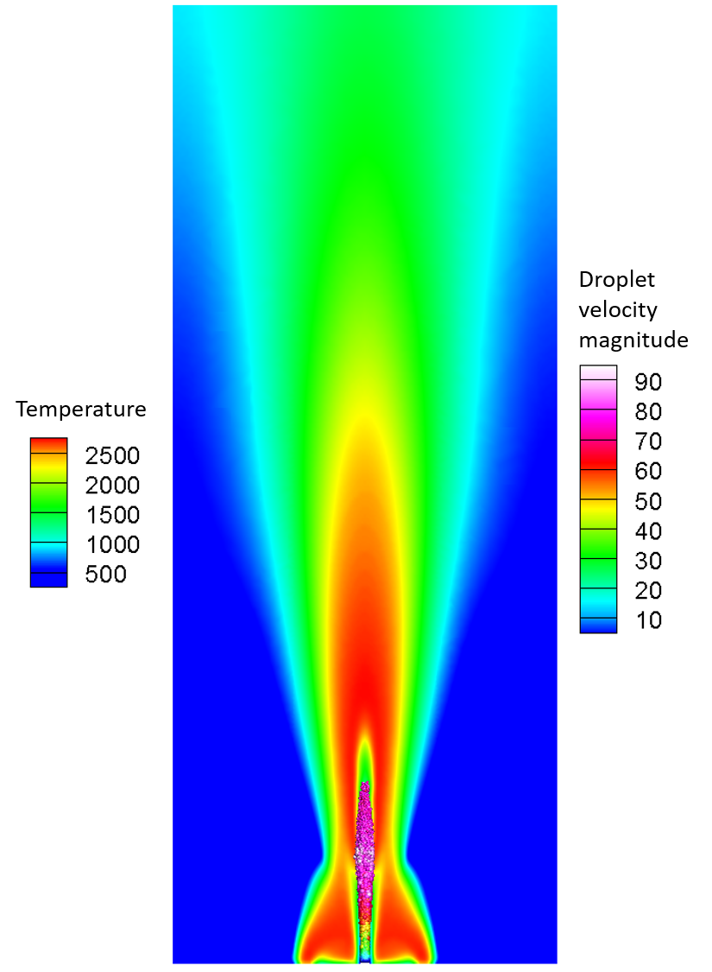
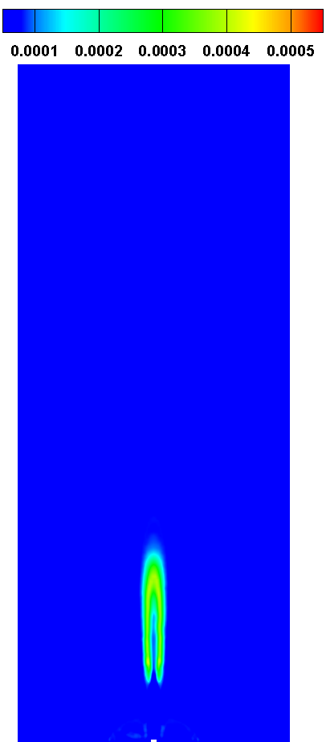
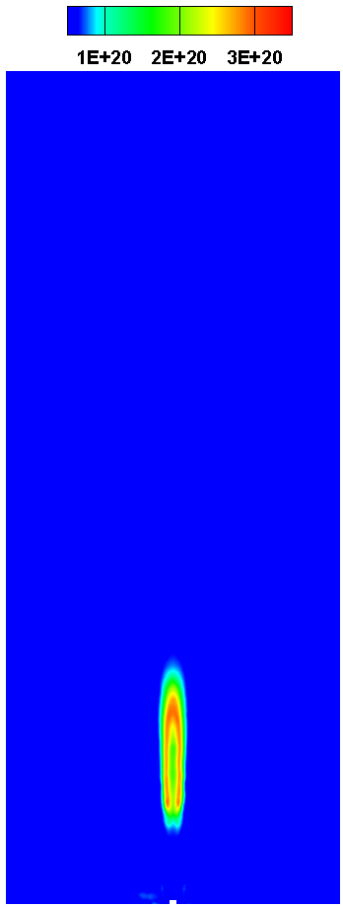
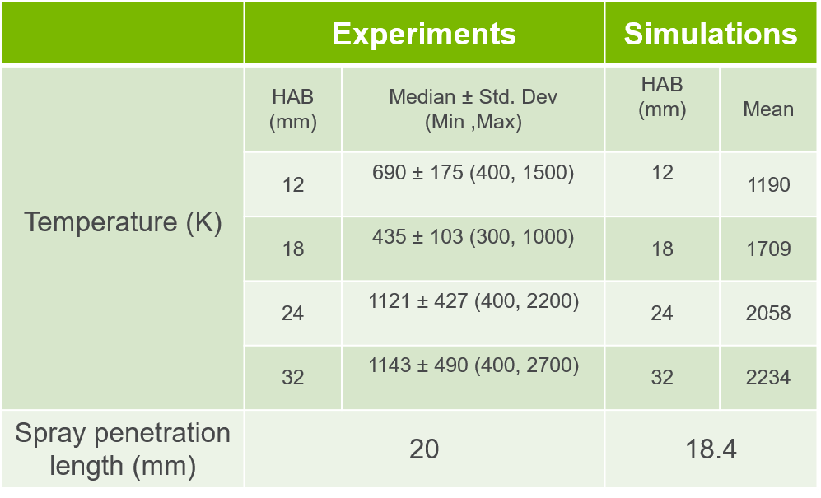
Key Technical Milestones (cont.)
Develop and test simplified CFD model (3/31/2019, completed)
Impact: New CFD capability at ANL, validated against pilot flame simulation [1]
Particle number density [1/m³]
SiO₂ mass fraction [-]
Dip in temperature
Sharp increase followed by plateauing
Droplet velocity magnitude [m/s]
Temperature [K]
[1] Weisse et al., Proc. Combust. Institute (2015)

Slide 4
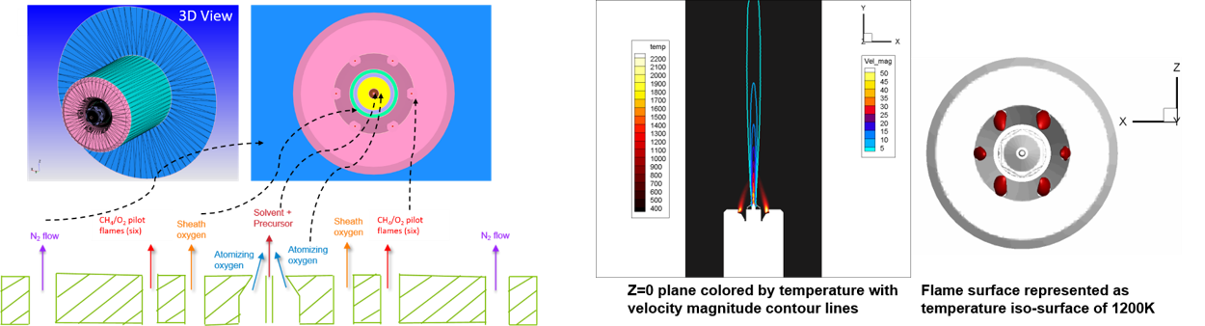
Key Technical MilestoneS (cont.)
Develop and test simplified CFD model (3/31/2019, completed)
Impact: New 3D CFD simulation capability to improve understanding of FSP at MERF facility and generate more data for ML
Schematic of the FSP reactor setup
Sample results for pilot flame stabilization
D. Dasgupta et al., 2019, in preparation

Slide 5
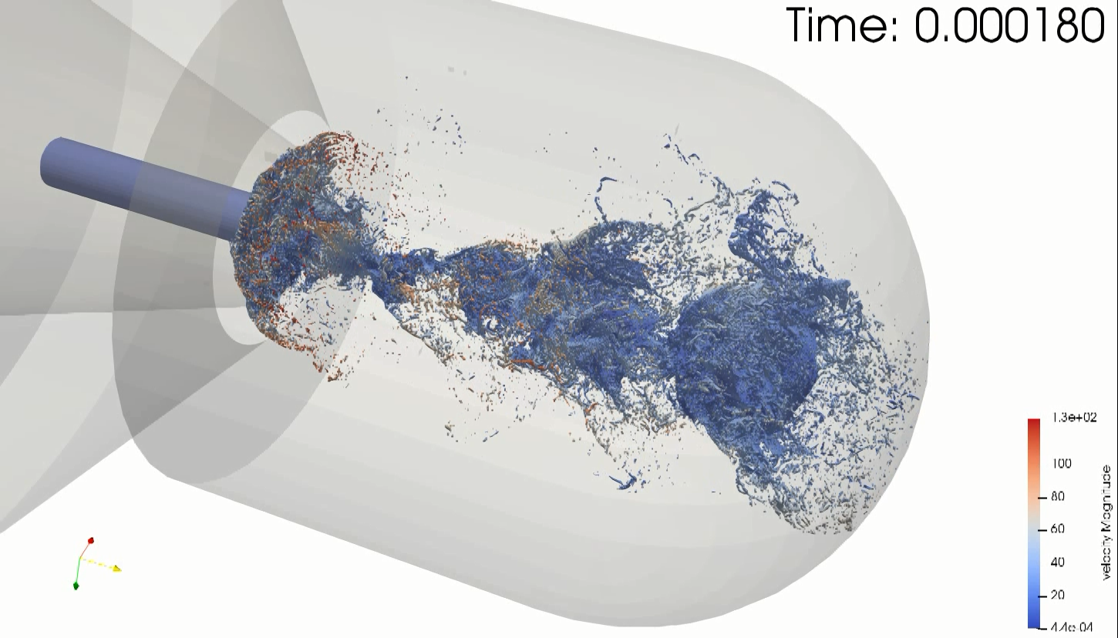
Key Technical MilestoneS (cont.)
Develop and test simplified CFD model (3/31/2019, completed)
Impact: New 3D CFD simulation capability to improve understanding of FSP at MERF facility and generate more data for ML
Detailed Volume of Fluids (VOF) simulations performed for the MERF burner
Provides new insights into the primary breakup mechanism of precursor/solvent mixture
Used to estimate the droplet size distribution for initializing the Lagrangian spray model used in RANS simulations
 | α ≤ 0.5 | α ≤ 0.7 | α ≤ 0.9
Overall SMD* [µm] | 22.0 | 22.5 | 25.0
*
Based on different threshold values for gas volume fraction (α) to determine the droplet sizes
D. Dasgupta et al., 2019, in preparation

Slide 6

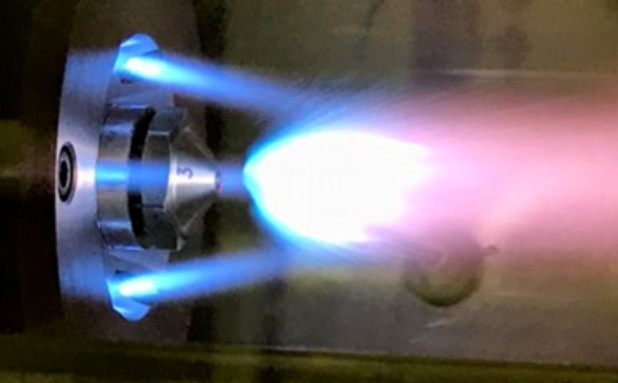
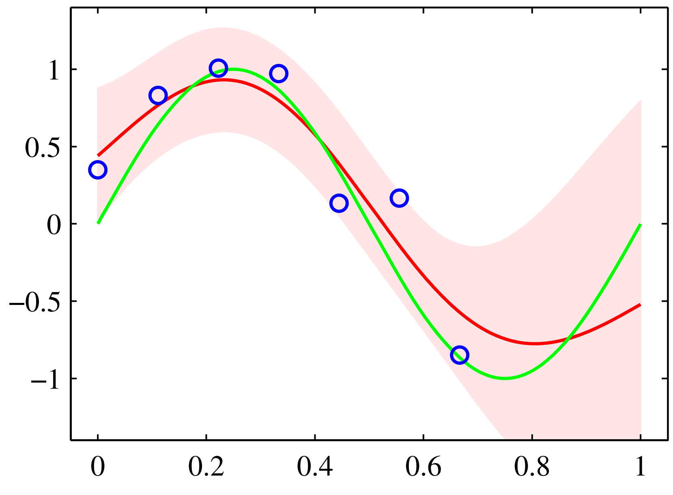

FY20 VISION: A team of humans and intelligent software has performed a real-time optimization of a synthesis process
Data collection: particle size distributions; phase composition, flame stability …
Machine learning develops the model
Flame Spray Pyrolysis
Intelligent Python software drives the optimization
Active learning updates processing parameters
M. Stan et al., 2019, in preparation
6
Notes:
Scanning Mobility Particle Sizer - Spectrometry

